Slide 1

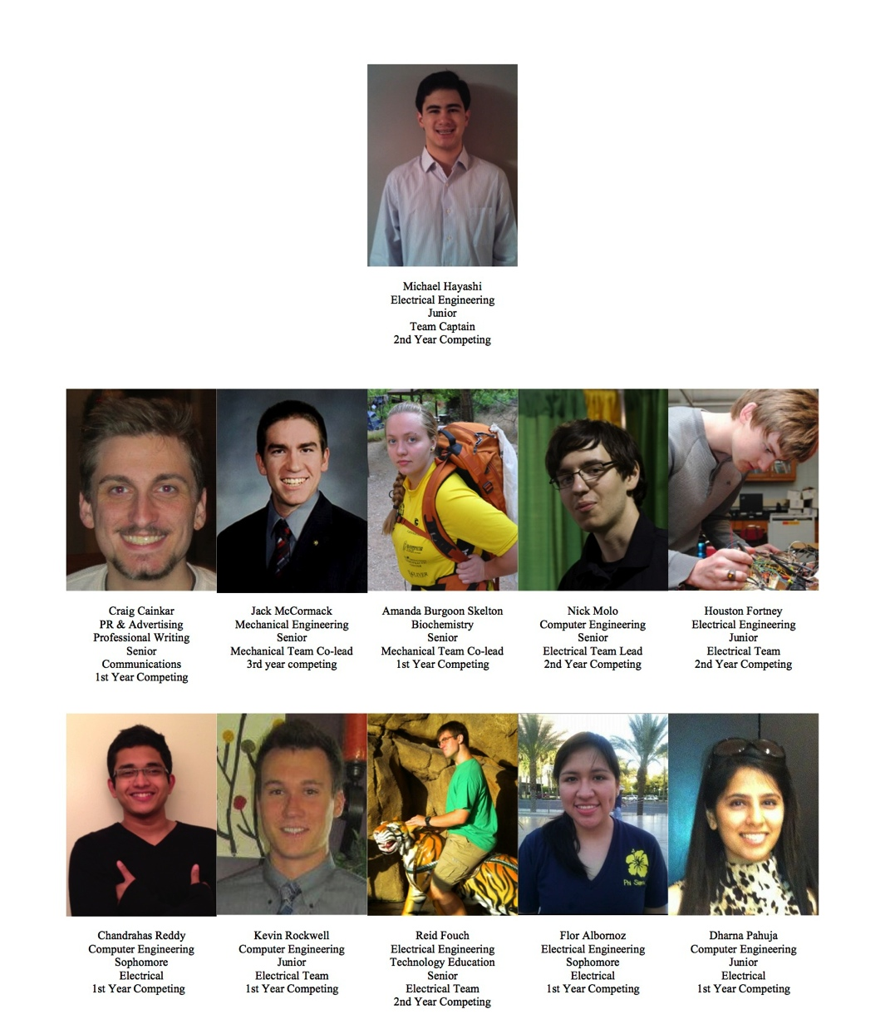
Introduction
Manipulator
Measuring Tool
Turning Motors
Thrusters
Electronics Box
Frame
Cameras
Buoyancy & Ballast
Tether
Pneumatics
Transmissometer
Electronics
Software
Expenses
Safety
Scheduling
Outreach
Acknowledgements

Slide 2
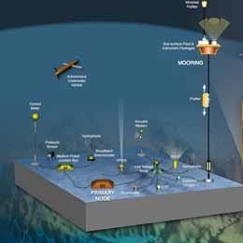
Introduction
Manipulator
Measuring Tool
Turning Motors
Thrusters
Electronics Box
Frame
Cameras
Buoyancy & Ballast
Tether
Pneumatics
Transmissometer
Electronics
Software
Expenses
Safety
Scheduling
Outreach
Acknowledgements
Mission Theme
Increasing interdependence between humanity and the sea
Desire to monitor the ocean continuously for our safety and quality of life
Need ROVs to deploy and maintenance an ocean observing system (OOS)

Slide 3

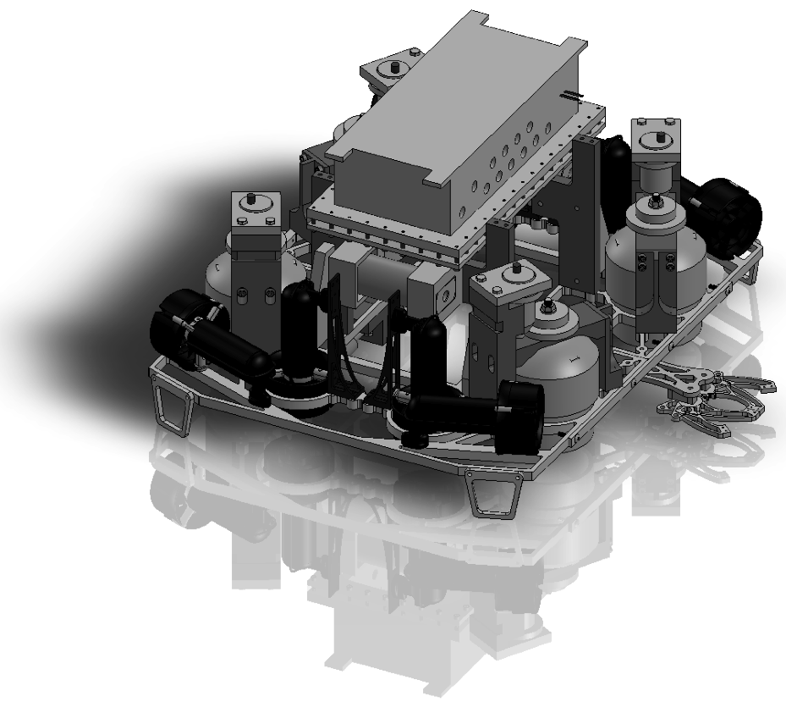
Introduction
Manipulator
Measuring Tool
Turning Motors
Thrusters
Electronics Box
Frame
Cameras
Buoyancy & Ballast
Tether
Pneumatics
Transmissometer
Electronics
Software
Expenses
Safety
Scheduling
Outreach
Acknowledgements

Slide 4
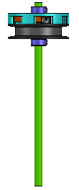
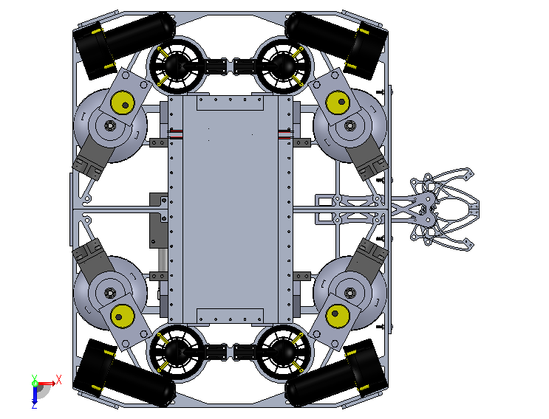

Introduction
Manipulator
Measuring Tool
Turning Motors
Thrusters
Electronics Box
Frame
Cameras
Buoyancy & Ballast
Tether
Pneumatics
Transmissometer
Electronics
Software
Expenses
Safety
Scheduling
Outreach
Acknowledgements
Design Overview
Built Around the Mission
Only began design once mission was released

Slide 5
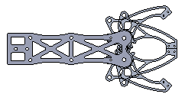
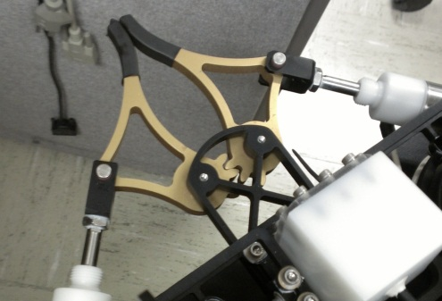
Introduction
Manipulator
Measuring Tool
Turning Motors
Thrusters
Electronics Box
Frame
Cameras
Buoyancy & Ballast
Tether
Pneumatics
Transmissometer
Electronics
Software
Expenses
Safety
Scheduling
Outreach
Acknowledgements
Manipulator
Fixed for simplicity
Sorbothane polyurethane used for the tips
Geared for symmetrical operation

Slide 6
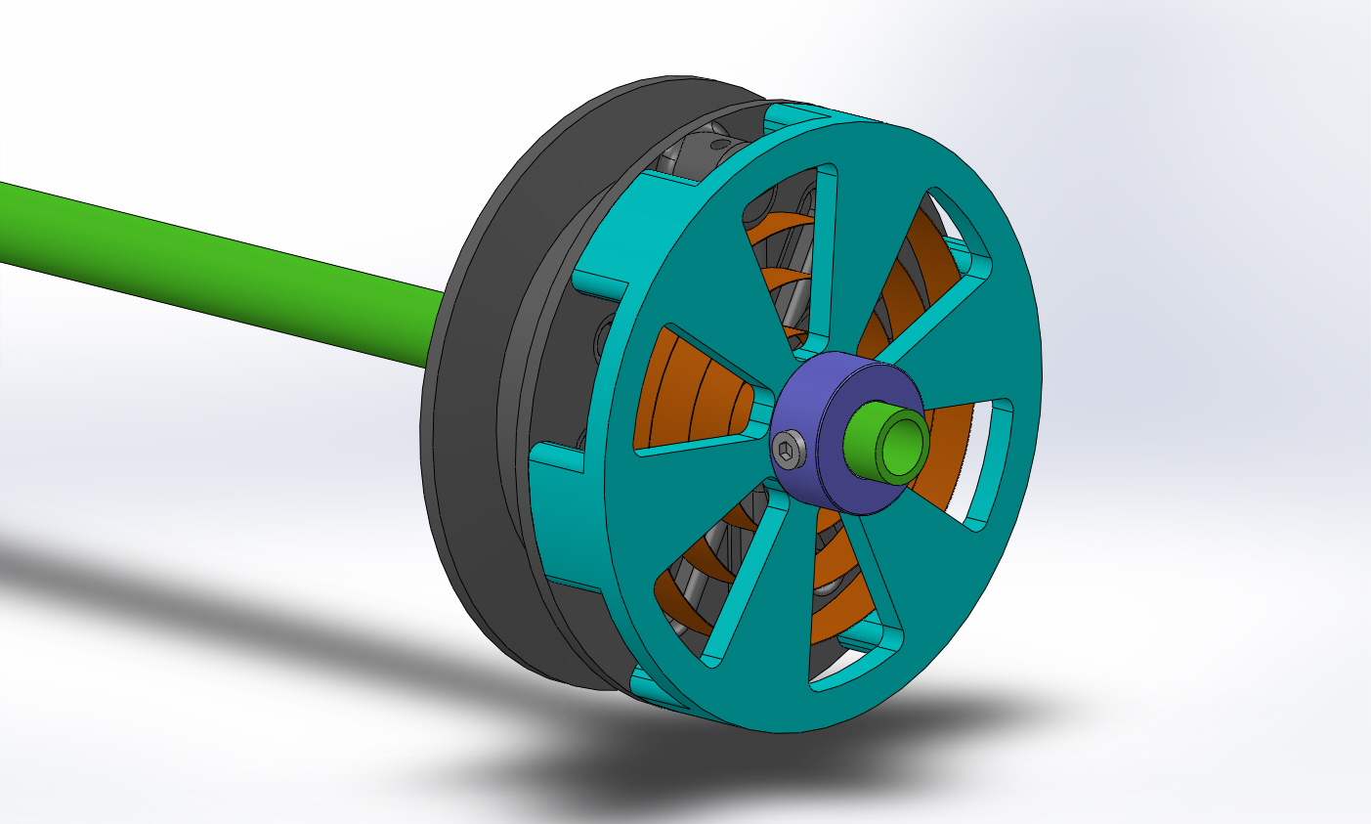
Introduction
Manipulator
Measuring Tool
Turning Motors
Thrusters
Electronics Box
Frame
Cameras
Buoyancy & Ballast
Tether
Pneumatics
Transmissometer
Electronics
Software
Expenses
Safety
Scheduling
Outreach
Acknowledgements
Measuring Tool
Spring-loaded to make sure tab does not catch on environment besides pipe of BIA
Gray code encoder reads unwound length down to 2 cm

Slide 7
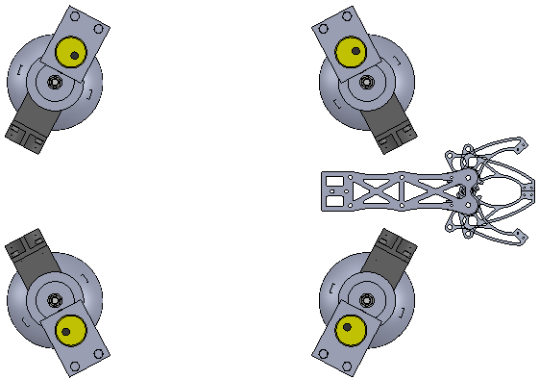
Introduction
Manipulator
Measuring Tool
Turning Motors
Thrusters
Electronics Box
Frame
Cameras
Buoyancy & Ballast
Tether
Pneumatics
Transmissometer
Electronics
Software
Expenses
Safety
Scheduling
Outreach
Acknowledgements
Turning Motors
Spaced to fit over legs of SIA
3:1 drive gears increase torque output of bilge motors
Two tines under shrouds level the SIA based on accelerometer data
Manual fine-tuning available on the base station

Slide 8
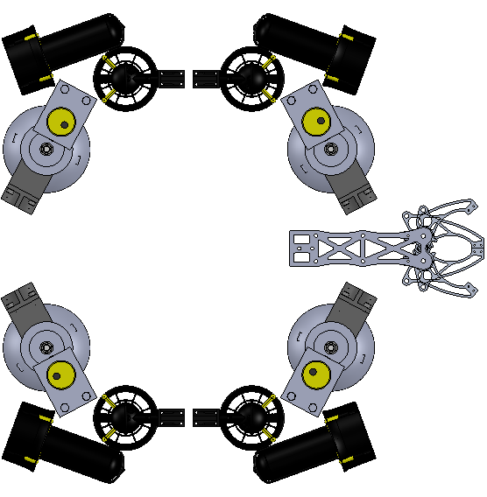
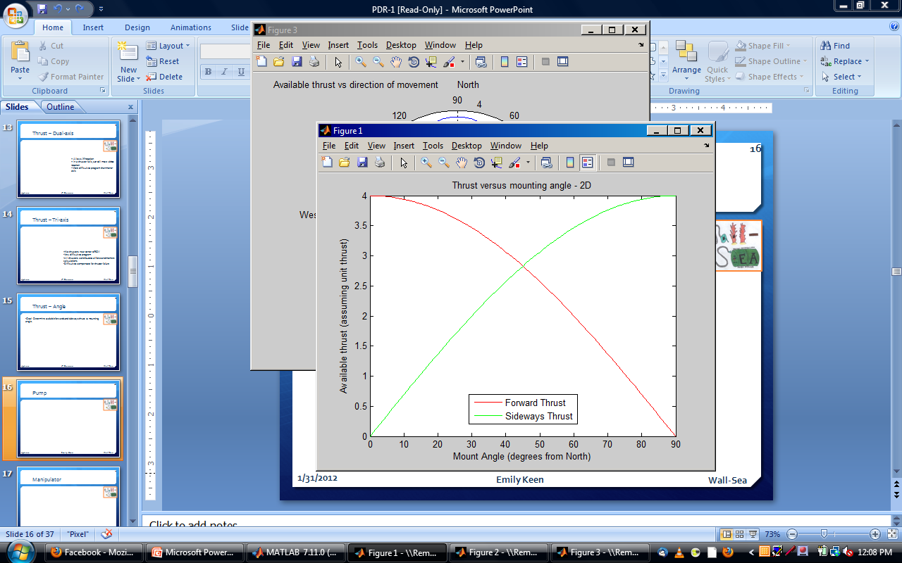
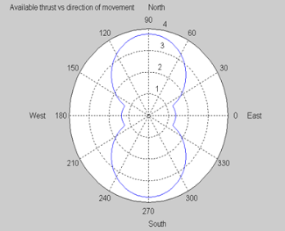
Introduction
Manipulator
Measuring Tool
Turning Motors
Thrusters
Electronics Box
Frame
Cameras
Buoyancy & Ballast
Tether
Pneumatics
Transmissometer
Electronics
Software
Expenses
Safety
Scheduling
Outreach
Acknowledgements
Thrusters
Eight thrusters for control over all axis of motion
Vertical thrusters placed to offer maximum pitch
Horizontal thrusters at 20 degree angle for sway

Slide 9
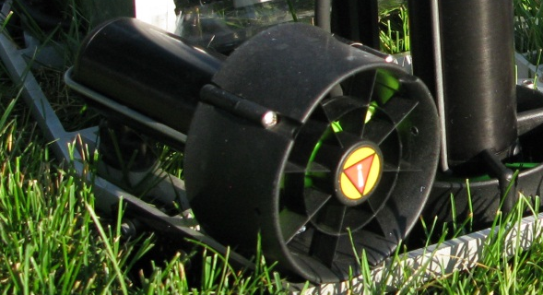
Introduction
Manipulator
Measuring Tool
Turning Motors
Thrusters
Electronics Box
Frame
Cameras
Buoyancy & Ballast
Tether
Pneumatics
Transmissometer
Electronics
Software
Expenses
Safety
Scheduling
Outreach
Acknowledgements
Thrusters
SeaBotix SBT166 Thrusters
Custom-ordered to run at 50 Vdc with RS-485 serial communication
Peak thrust of 2.9 kg per thruster

Slide 10
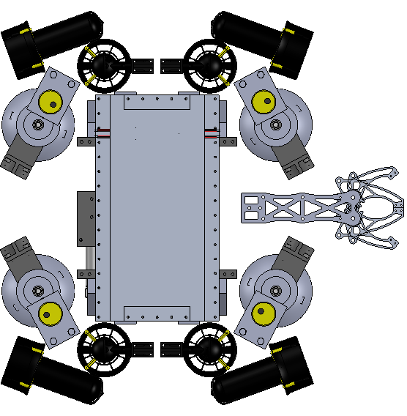
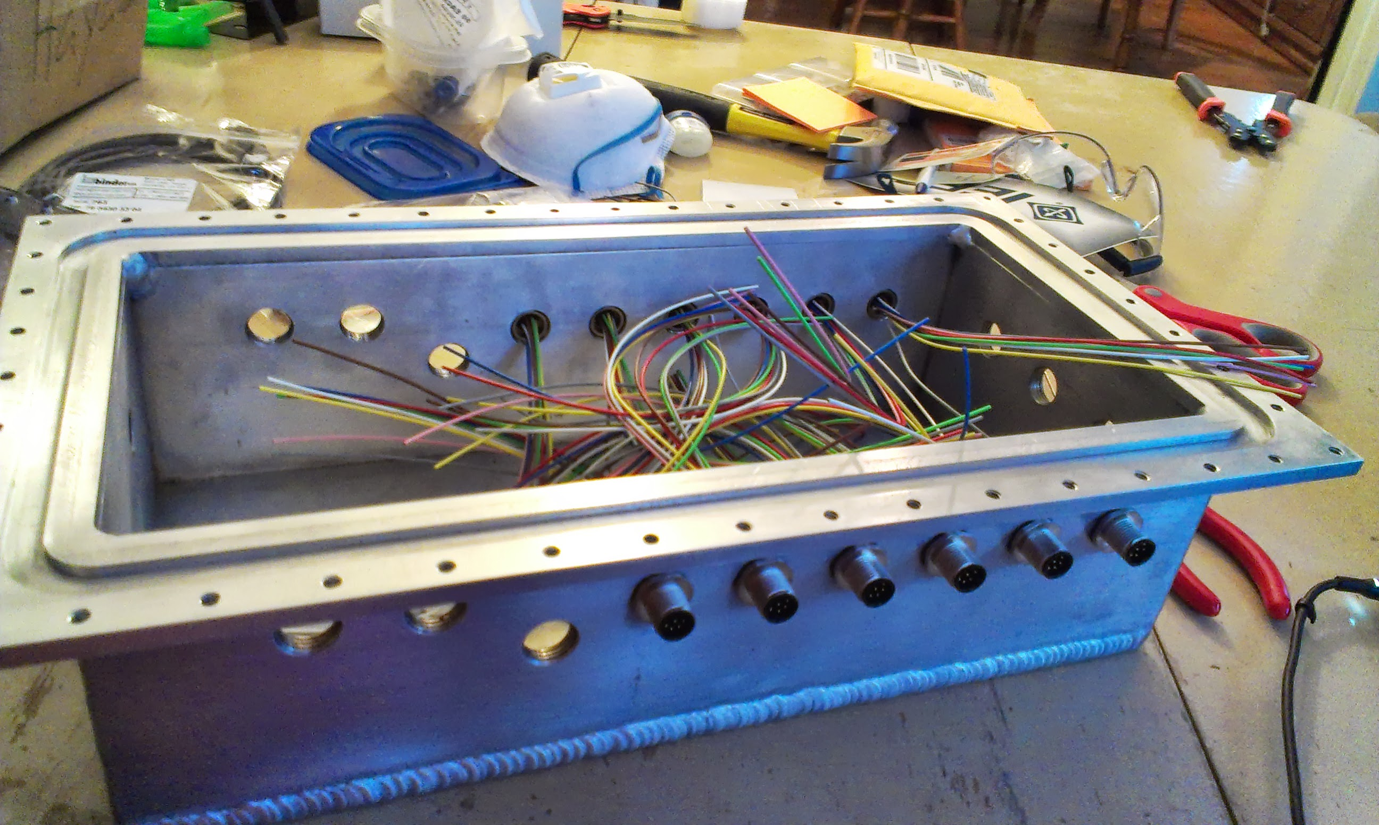
Introduction
Manipulator
Measuring Tool
Turning Motors
Thrusters
Electronics Box
Frame
Cameras
Buoyancy & Ballast
Tether
Pneumatics
Transmissometer
Electronics
Software
Expenses
Safety
Scheduling
Outreach
Acknowledgements
Electronics Box
Simple box made from welded aluminum with Lexan cover bolted on underside
Incredibly large volume

Slide 11
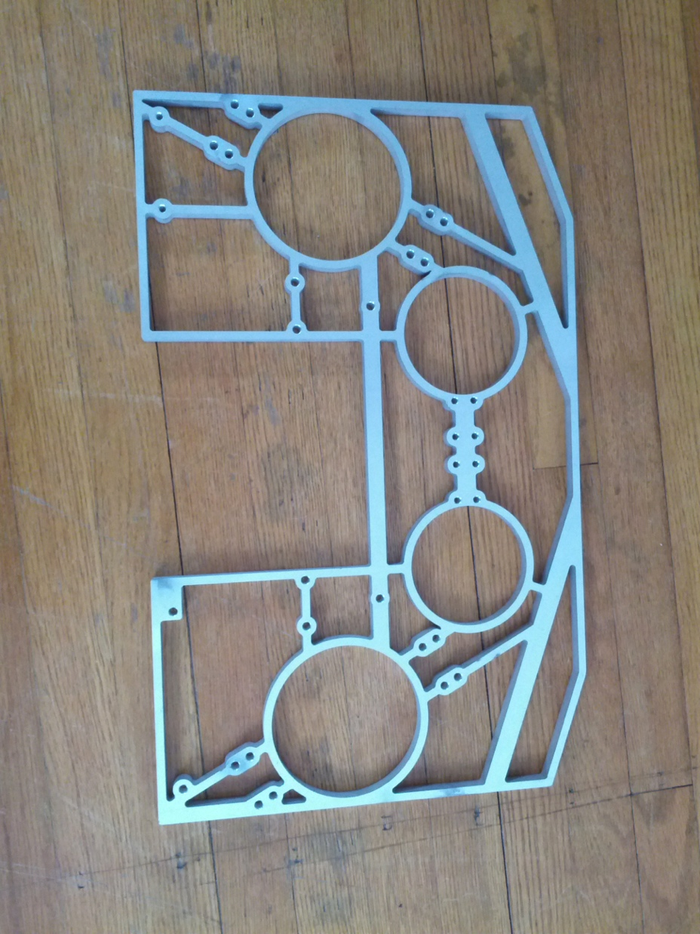
Introduction
Manipulator
Measuring Tool
Turning Motors
Thrusters
Electronics Box
Frame
Cameras
Buoyancy & Ballast
Tether
Pneumatics
Transmissometer
Electronics
Software
Expenses
Safety
Scheduling
Outreach
Acknowledgements
Base Frame
1.27-cm thick anodized aluminum waterjet frame

Slide 12
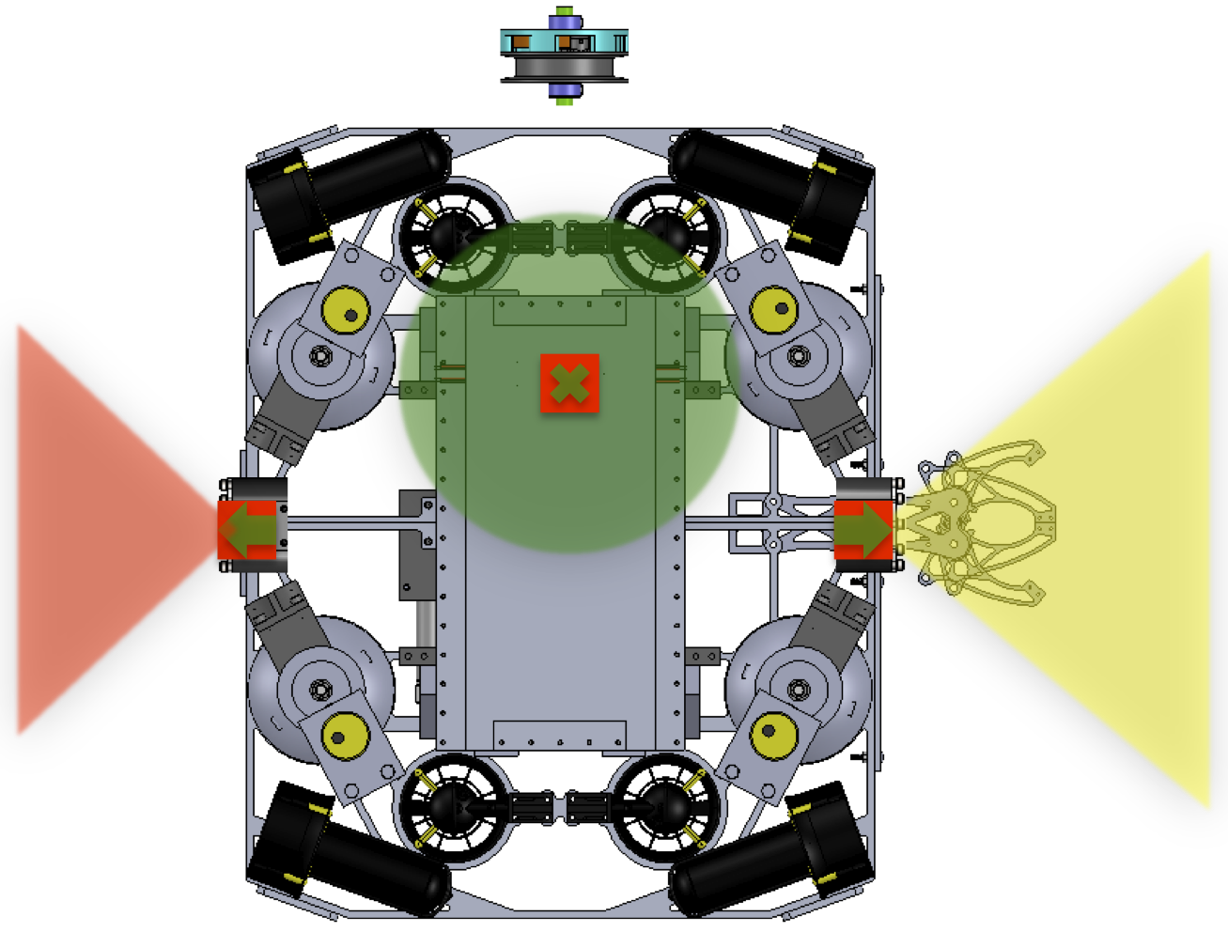
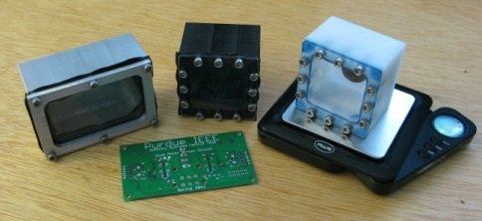
Introduction
Manipulator
Measuring Tool
Turning Motors
Thrusters
Electronics Box
Frame
Cameras
Buoyancy & Ballast
Tether
Pneumatics
Transmissometer
Electronics
Software
Expenses
Safety
Scheduling
Outreach
Acknowledgements
Cameras
2 Super Circuits Wide Angle Board Cameras in custom Taulman 618 enclosures
1 identical camera in electronics box facing down to assist leveling the SIA

Slide 13
Introduction
Manipulator
Measuring Tool
Turning Motors
Thrusters
Electronics Box
Frame
Cameras
Buoyancy & Ballast
Tether
Pneumatics
Transmissometer
Electronics
Software
Expenses
Safety
Scheduling
Outreach
Acknowledgements
Design Overview
Built Around the Mission

Slide 14
Introduction
Manipulator
Measuring Tool
Turning Motors
Thrusters
Electronics Box
Frame
Cameras
Buoyancy & Ballast
Tether
Pneumatics
Transmissometer
Electronics
Software
Expenses
Safety
Scheduling
Outreach
Acknowledgements
Buoyancy & Ballast
Most buoyancy provided by electronics box
Hydrostatic proof foam for slight positive buoyancy
Fine tuning accomplished with ballast in each corner
Tether buoyancy is a strip of foam

Slide 15
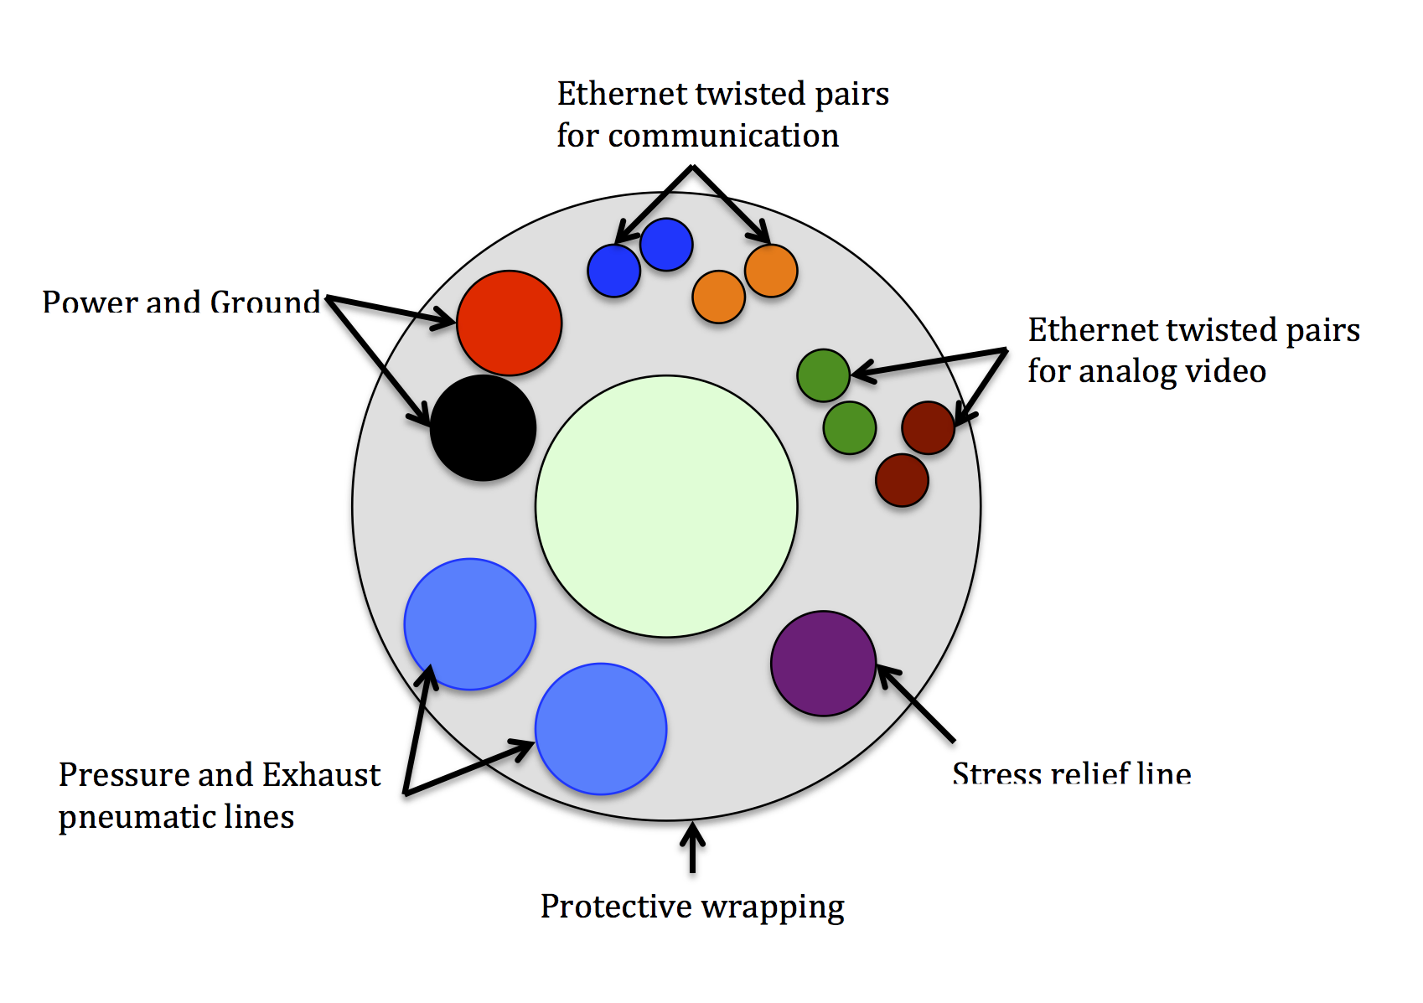
Introduction
Manipulator
Measuring Tool
Turning Motors
Thrusters
Electronics Box
Frame
Cameras
Buoyancy & Ballast
Tether
Pneumatics
Transmissometer
Electronics
Software
Expenses
Safety
Scheduling
Outreach
Acknowledgements
Tether
Contains:
Foam Buoyancy Strip
Twisted Pair 10 AWG Power and Ground
Pressure and Exhaust Pneumatic Lines
Ethernet Cable
2 TP used for communication
2 TP used for video
Stress Relief Line
Encased in protective wrapping

Slide 16
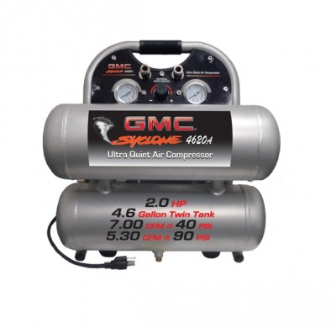
Introduction
Manipulator
Measuring Tool
Turning Motors
Thrusters
Electronics Box
Frame
Cameras
Buoyancy & Ballast
Tether
Pneumatics
Transmissometer
Electronics
Software
Expenses
Safety
Scheduling
Outreach
Acknowledgements
Pneumatics
Air compressor on the surface with regulator and quick drain valve
Accumulators on vehicle for faster response times
Managed on vehicle by solenoid bank
Exhausted back to surface for higher pressure differential

Slide 17
Introduction
Manipulator
Measuring Tool
Turning Motors
Thrusters
Electronics Box
Frame
Cameras
Buoyancy & Ballast
Tether
Pneumatics
Transmissometer
Electronics
Software
Expenses
Safety
Scheduling
Outreach
Acknowledgements
Transmissometer
Housed in PVC frame using camera boxes
Has own tether for 12 V power and Ethernet cable
Entirely custom electronics system
Transmissometer TX Board
Transmissometer RX Board
Transmissometer Surface Board

Slide 18
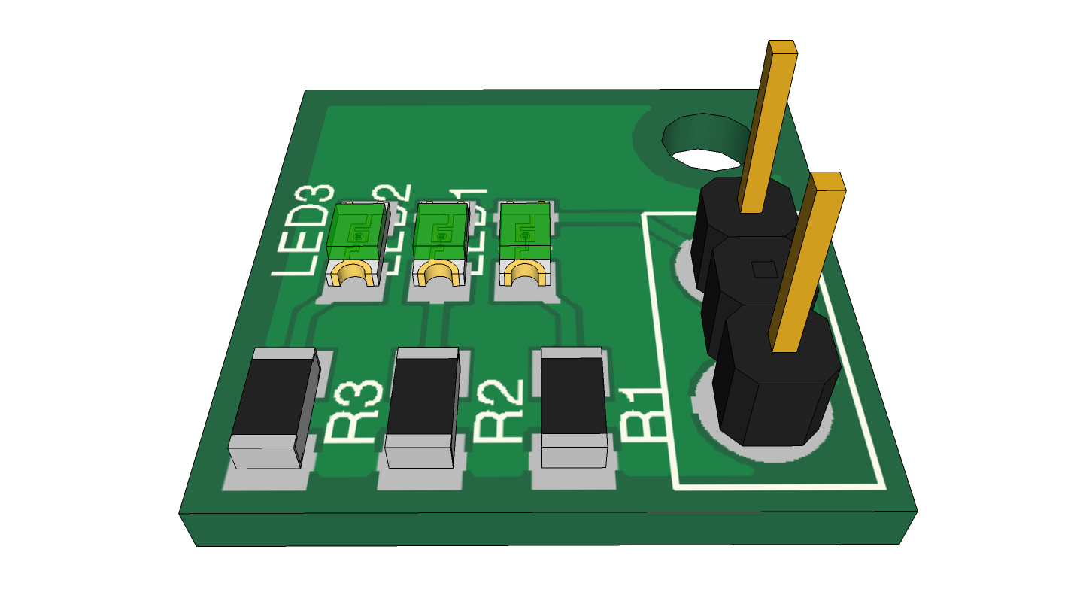
Introduction
Manipulator
Measuring Tool
Turning Motors
Thrusters
Electronics Box
Frame
Cameras
Buoyancy & Ballast
Tether
Pneumatics
Transmissometer
Electronics
Software
Expenses
Safety
Scheduling
Outreach
Acknowledgements
Transmissometer
Controls 3 infrared LEDs spaced 1 cm apart
Controlled from surface at positive and negative ends
Transmissometer TX Board

Slide 19
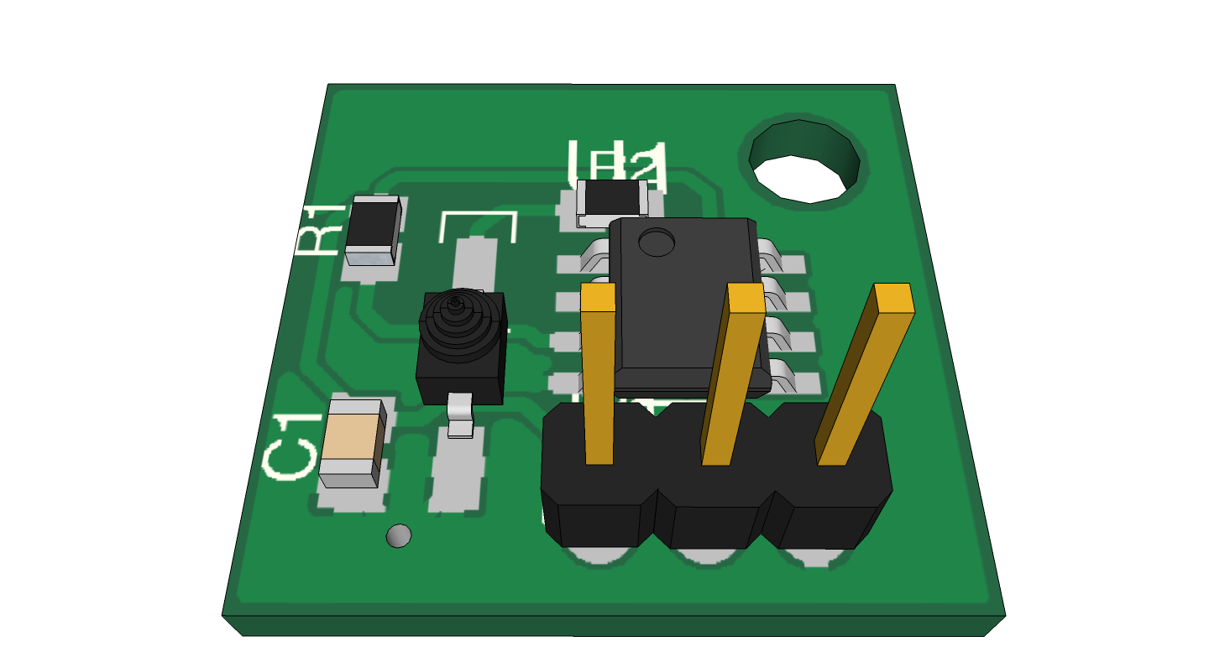
Introduction
Manipulator
Measuring Tool
Turning Motors
Thrusters
Electronics Box
Frame
Cameras
Buoyancy & Ballast
Tether
Pneumatics
Transmissometer
Electronics
Software
Expenses
Safety
Scheduling
Outreach
Acknowledgements
Transmissometer
Phototransistor receives attenuated light from transmissometer TX board
Voltage follower used to prevent signal degradation on return to transmissometer surface board
Transmissometer RX Board

Slide 20
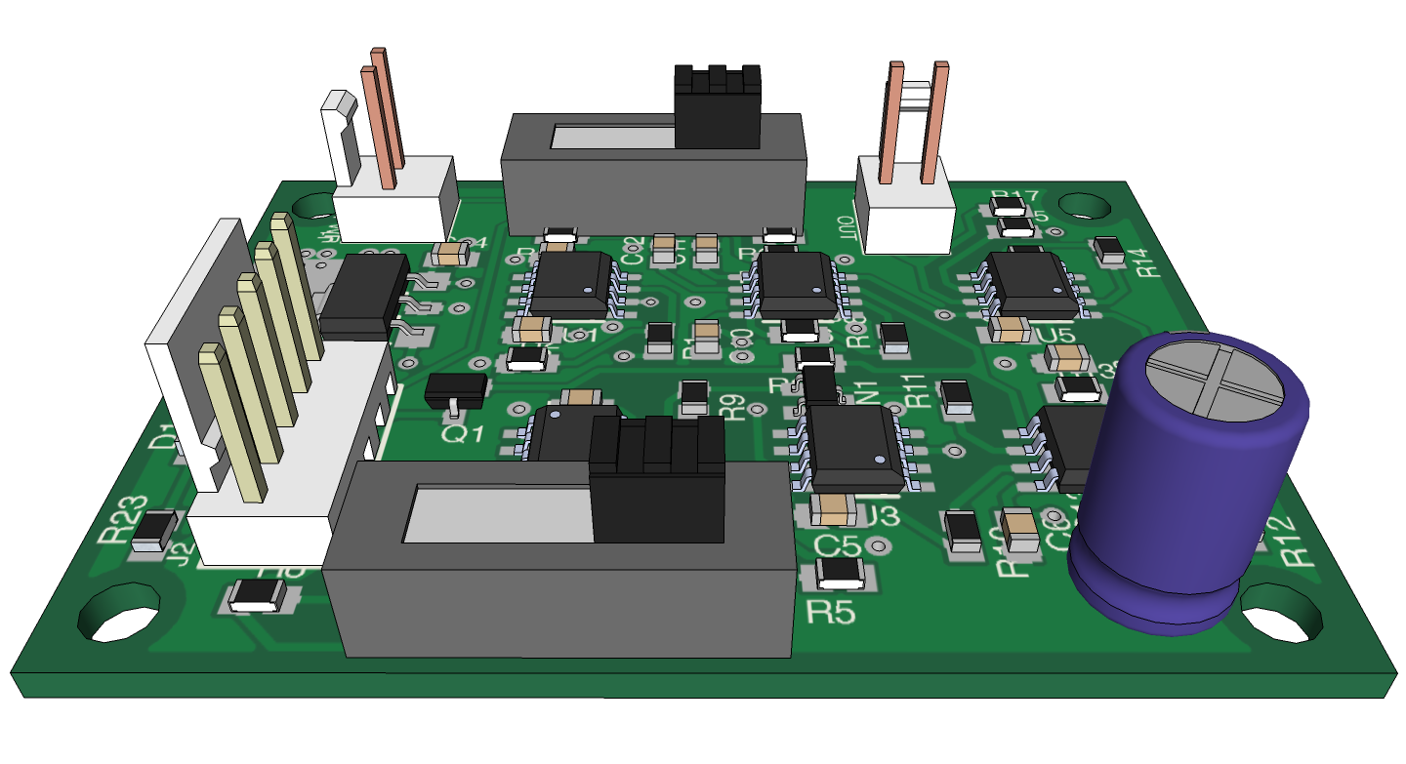
Introduction
Manipulator
Measuring Tool
Turning Motors
Thrusters
Electronics Box
Frame
Cameras
Buoyancy & Ballast
Tether
Pneumatics
Transmissometer
Electronics
Software
Expenses
Safety
Scheduling
Outreach
Acknowledgements
Transmissometer
Compares signal from RX board to signal in-phase and at same frequency toggling LEDs
Lock-in amplifier generates a DC signal associated with that frequency
Vernier Voltage probe allows interpretation of DC value as ocean turbidity
Software tracks changes against time
Transmissometer Surface Board

Slide 21
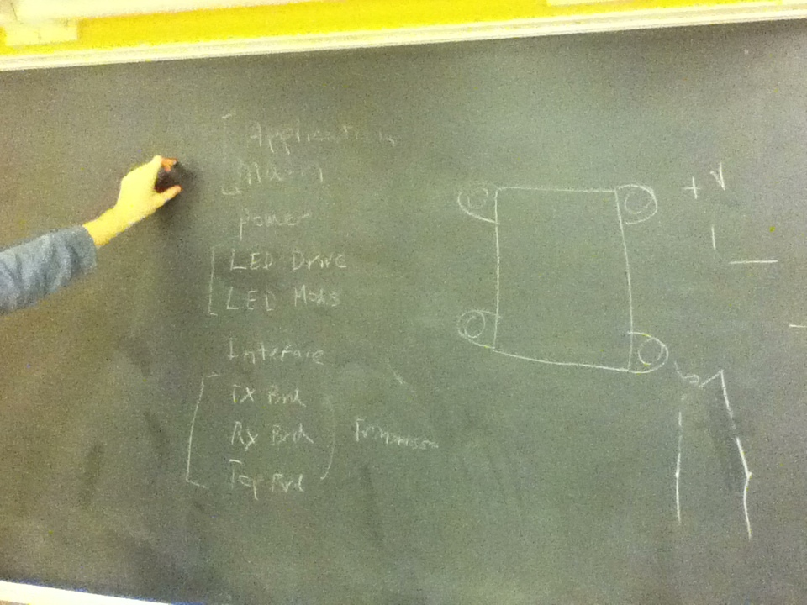
Introduction
Manipulator
Measuring Tool
Turning Motors
Thrusters
Electronics Box
Frame
Cameras
Buoyancy & Ballast
Tether
Pneumatics
Transmissometer
Electronics
Software
Expenses
Safety
Scheduling
Outreach
Acknowledgements
Electronics
Entirely custom electronics system
Main Microcontroller Board
Microcontroller Adaptor Board
Application Board
Power Board
Interface Adapter Board

Slide 22
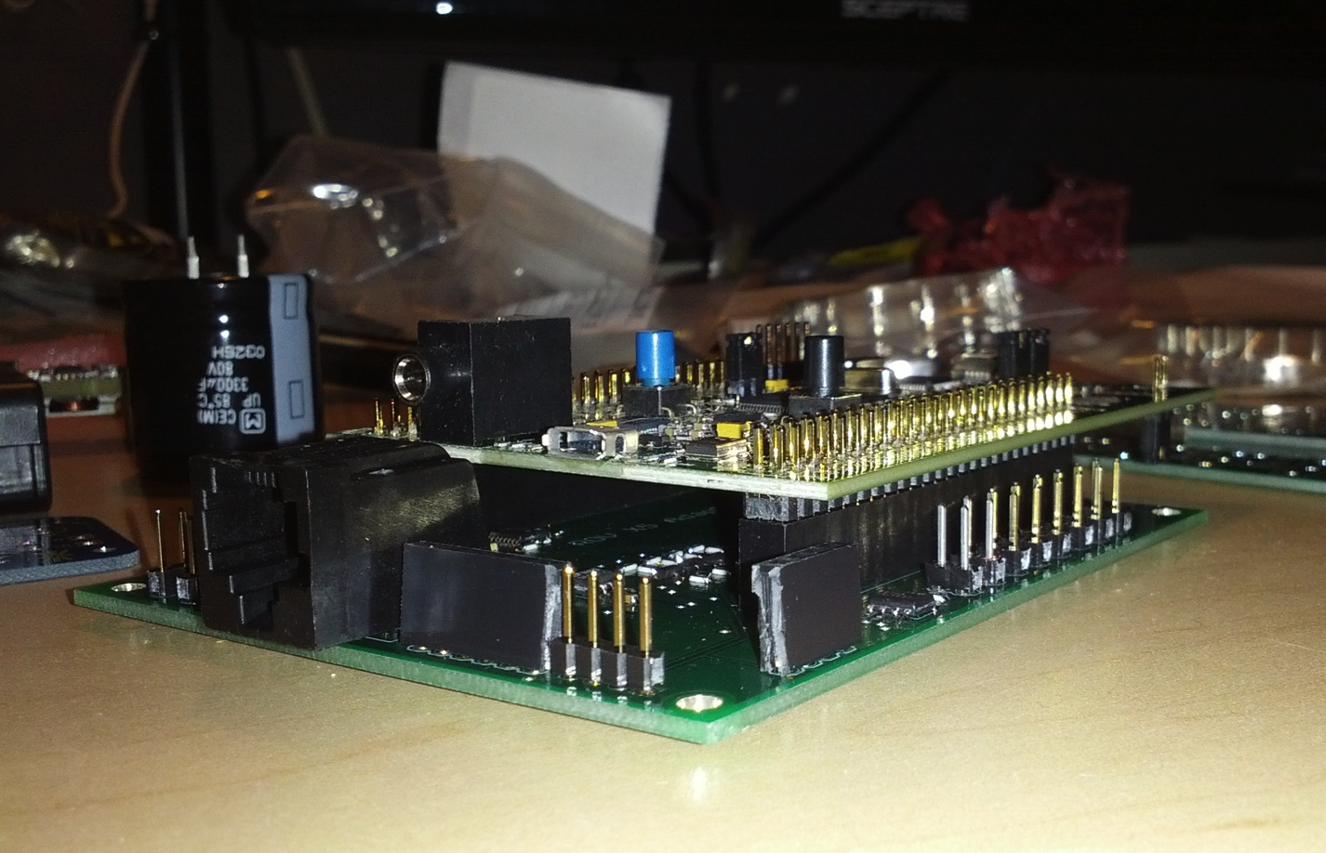
Introduction
Manipulator
Measuring Tool
Turning Motors
Thrusters
Electronics Box
Frame
Cameras
Buoyancy & Ballast
Tether
Pneumatics
Transmissometer
Electronics
Software
Expenses
Safety
Scheduling
Outreach
Acknowledgements
Electronics
Based on ARM Microprocessor
RS-485 serial protocol, for long distance communication
Manages thrusters, sensors, pneumatics, and inputs
Main Microcontroller Board

Slide 23
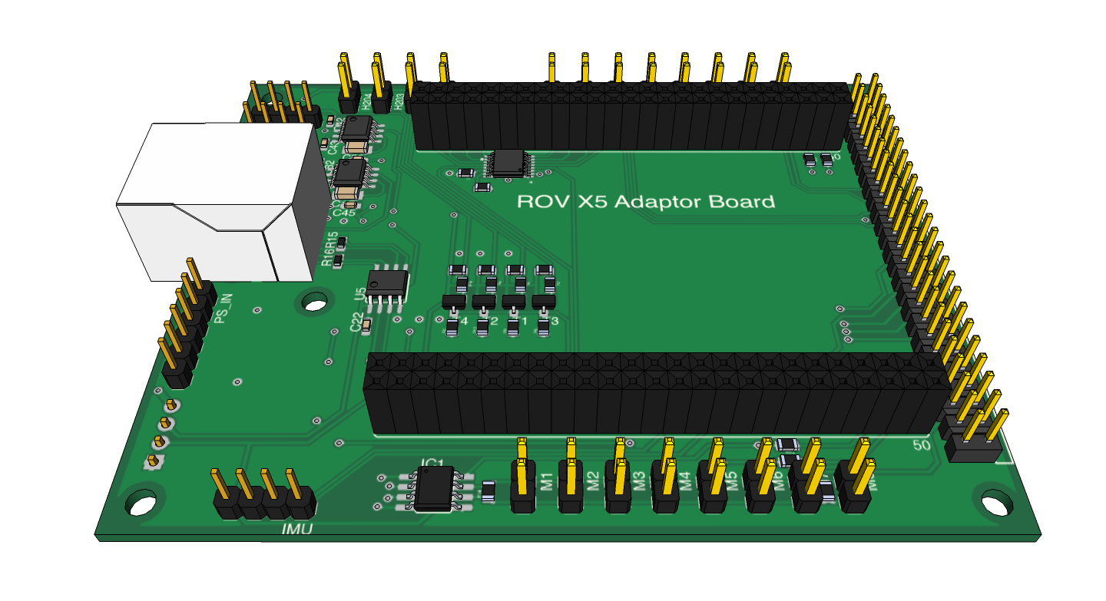
Introduction
Manipulator
Measuring Tool
Turning Motors
Thrusters
Electronics Box
Frame
Cameras
Buoyancy & Ballast
Tether
Pneumatics
Transmissometer
Electronics
Software
Expenses
Safety
Scheduling
Outreach
Acknowledgements
Electronics
Shield for main board and connection to application board
Input and output routed to GPIO pins on main board
RS-485 communication block and video switches here
Four water alert sensors to most suspect leak points
Microcontroller Adaptor Board

Slide 24
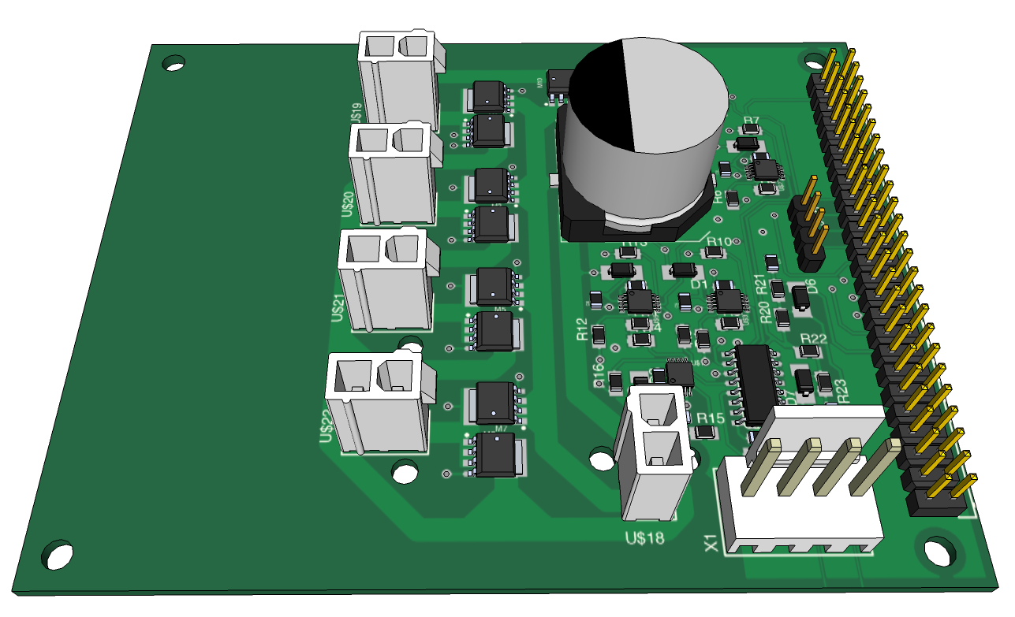
Introduction
Manipulator
Measuring Tool
Turning Motors
Thrusters
Electronics Box
Frame
Cameras
Buoyancy & Ballast
Tether
Pneumatics
Transmissometer
Electronics
Software
Expenses
Safety
Scheduling
Outreach
Acknowledgements
Electronics
Start of new yearly redesign plan
Separate high and low-side turning motor connections requires just 5 half-bridges
Each turning motor controlled individually using PWM and direction
Measuring tool encoder
Application Board

Slide 25
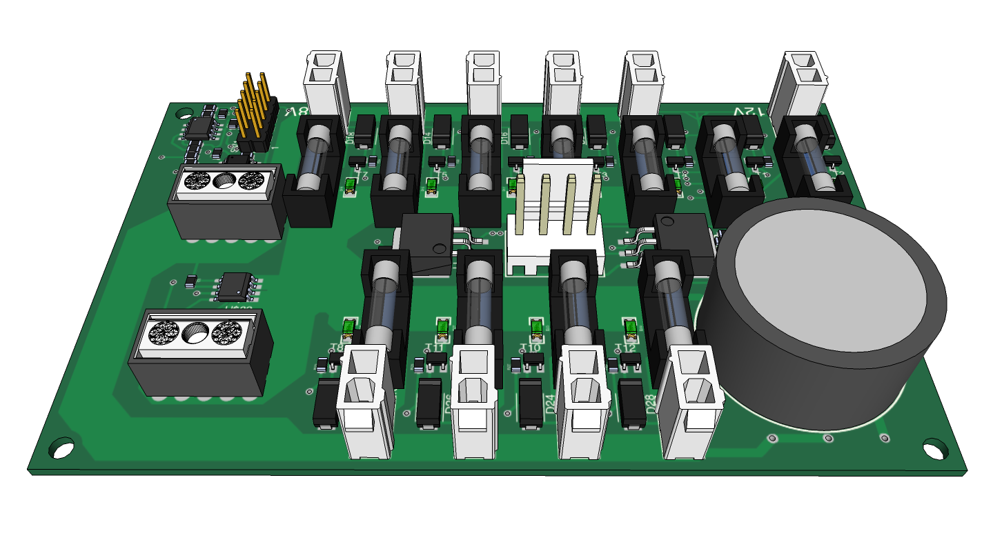
Introduction
Manipulator
Measuring Tool
Turning Motors
Thrusters
Electronics Box
Frame
Cameras
Buoyancy & Ballast
Tether
Pneumatics
Transmissometer
Electronics
Software
Expenses
Safety
Scheduling
Outreach
Acknowledgements
Electronics
Distributes 48 Vdc from tether to motors
Linear regulators make 12 Vdc, 5 Vdc, and 3.3 Vdc
Each output plug is individually fused
Temperature, current, voltage, and blown fuse sensing
Power Board

Slide 26
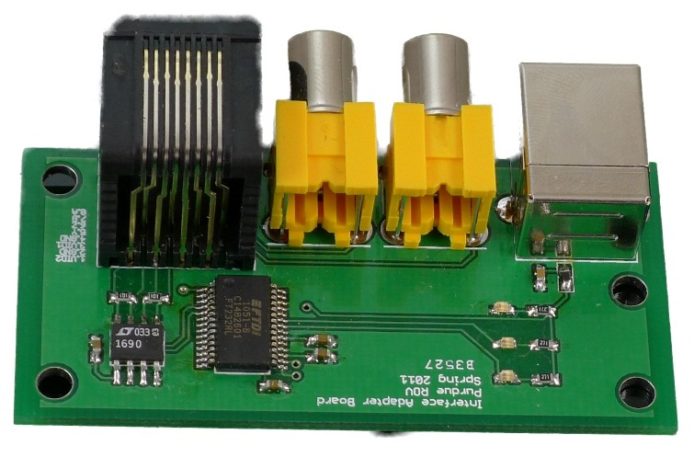
Introduction
Manipulator
Measuring Tool
Turning Motors
Thrusters
Electronics Box
Frame
Cameras
Buoyancy & Ballast
Tether
Pneumatics
Transmissometer
Electronics
Software
Expenses
Safety
Scheduling
Outreach
Acknowledgements
Electronics
Simplifies RS-485 serial to USB conversion, acts as a virtual communications port
Status indicators representing power, transmit, and receive
Easy access to video feeds
Interface Adapter Board

Slide 27
Introduction
Manipulator
Measuring Tool
Turning Motors
Thrusters
Electronics Box
Frame
Cameras
Buoyancy & Ballast
Tether
Pneumatics
Transmissometer
Electronics
Software
Expenses
Safety
Scheduling
Outreach
Acknowledgements
Software
Onboard Hardware Programmed in Embedded C
Base station software written in C++/CLI using Windows Forms to implement the GUI

Slide 28
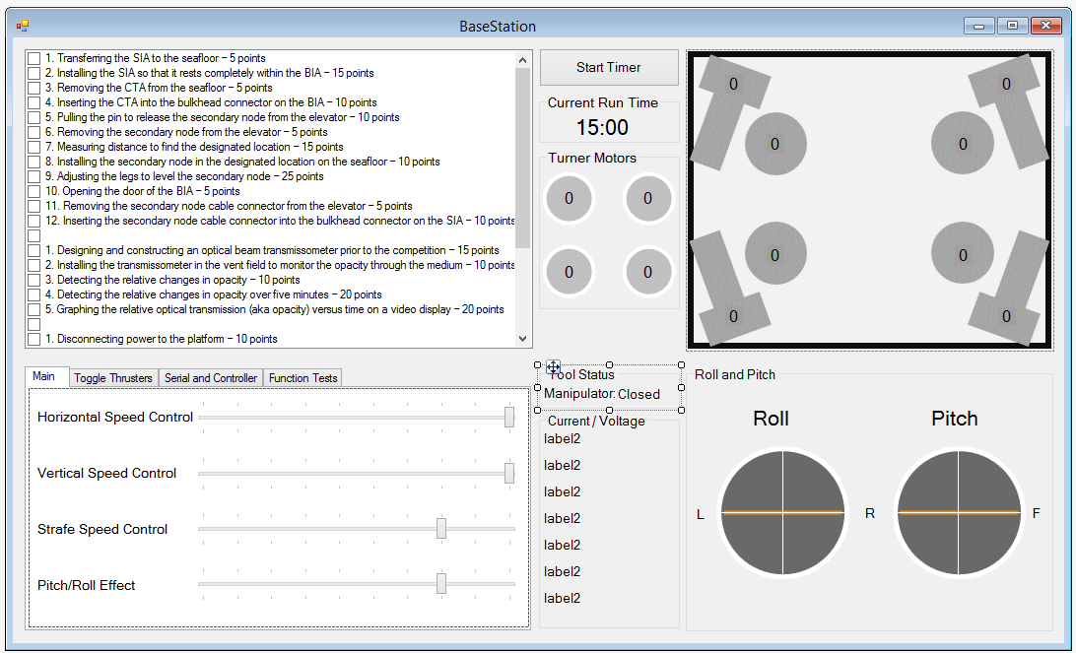
Introduction
Manipulator
Measuring Tool
Turning Motors
Thrusters
Electronics Box
Frame
Cameras
Buoyancy & Ballast
Tether
Pneumatics
Transmissometer
Electronics
Software
Expenses
Safety
Scheduling
Outreach
Acknowledgements
Software

Slide 29
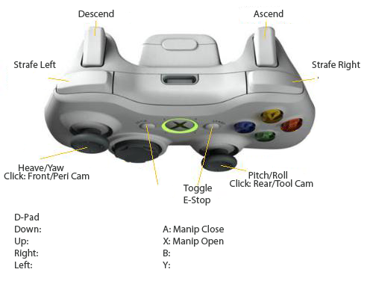
Introduction
Manipulator
Measuring Tool
Turning Motors
Thrusters
Electronics Box
Frame
Cameras
Buoyancy & Ballast
Tether
Pneumatics
Transmissometer
Electronics
Software
Expenses
Safety
Scheduling
Outreach
Acknowledgements
Software

Slide 30
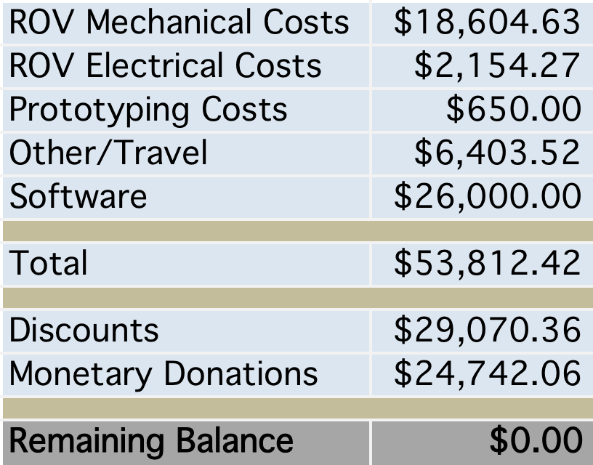
Introduction
Manipulator
Measuring Tool
Turning Motors
Thrusters
Electronics Box
Frame
Cameras
Buoyancy & Ballast
Tether
Pneumatics
Transmissometer
Electronics
Software
Expenses
Safety
Scheduling
Outreach
Acknowledgements
Expenses
Cost Distribution of Expenses
Unrelated to Travel or Software

Slide 31
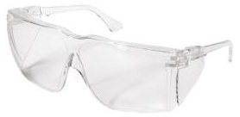
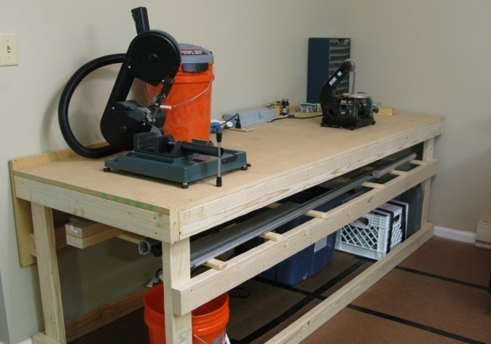
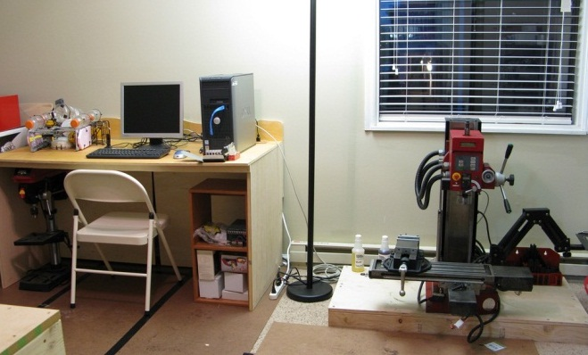
Introduction
Manipulator
Measuring Tool
Turning Motors
Thrusters
Electronics Box
Frame
Cameras
Buoyancy & Ballast
Tether
Pneumatics
Transmissometer
Electronics
Software
Expenses
Safety
Scheduling
Outreach
Acknowledgements
Safety
Electrical system has many fuses and safety mechanisms
All work done with power tools included safety glasses and surge protectors
ROV always uses GFI outlet near pools
Pneumatics has quick release valve and pressure regulator
No injuries during construction or operation of vehicle

Slide 32
Introduction
Manipulator
Measuring Tool
Turning Motors
Thrusters
Electronics Box
Frame
Cameras
Buoyancy & Ballast
Tether
Pneumatics
Transmissometer
Electronics
Software
Expenses
Safety
Scheduling
Outreach
Acknowledgements
Scheduling

Slide 33
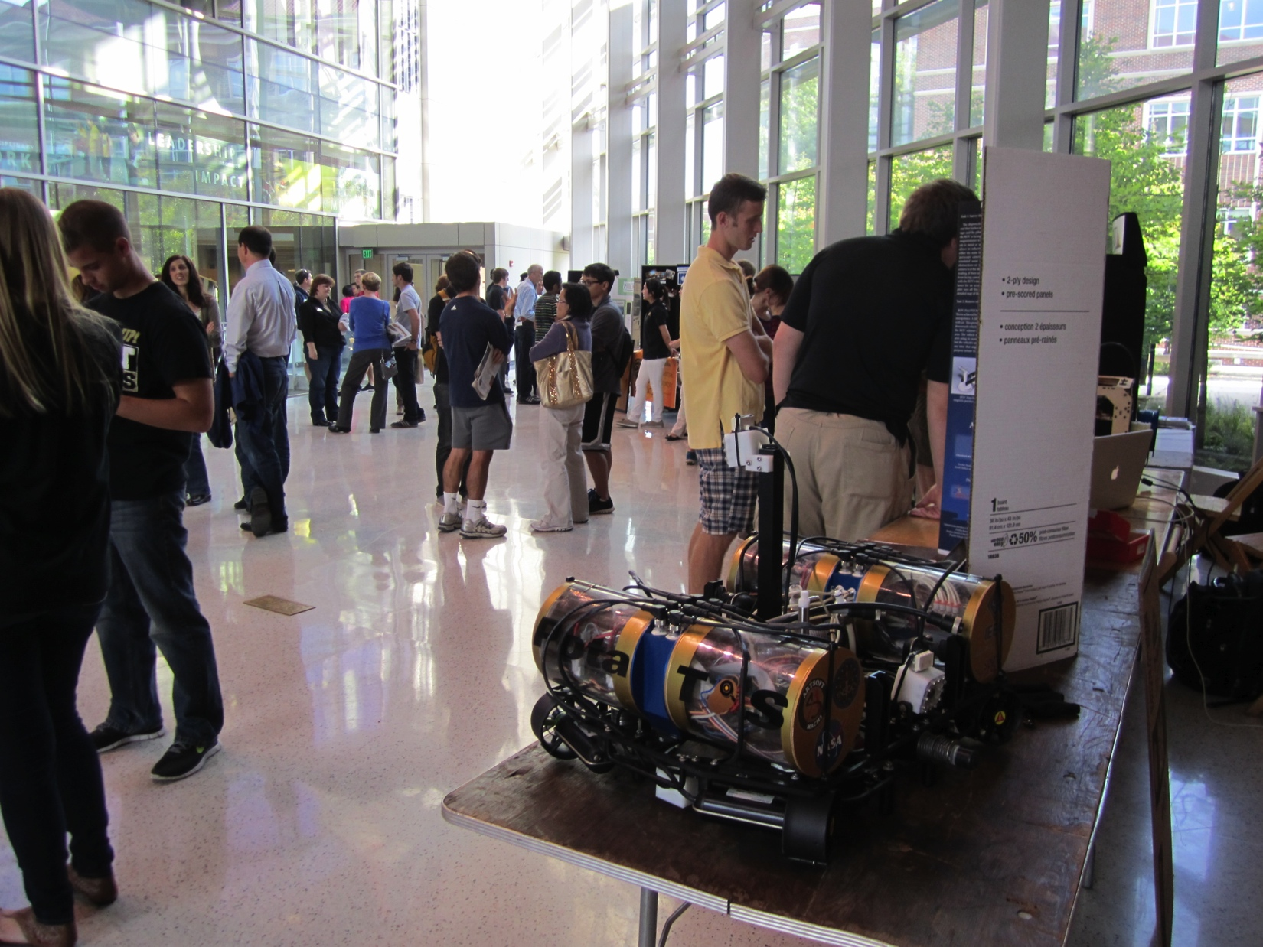
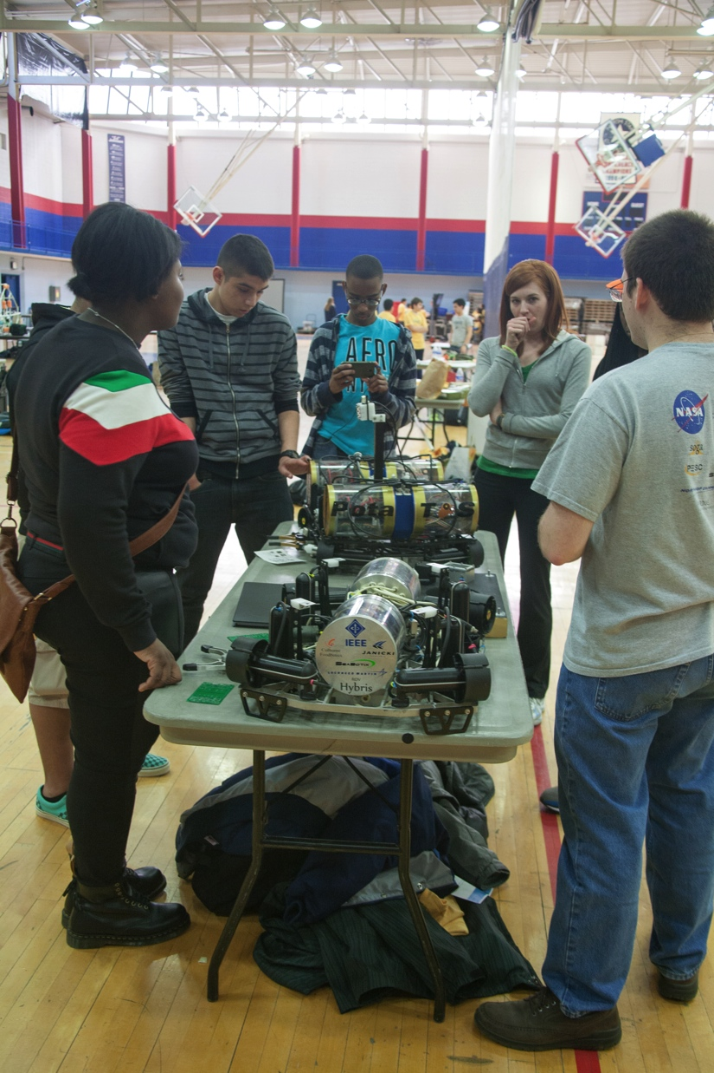
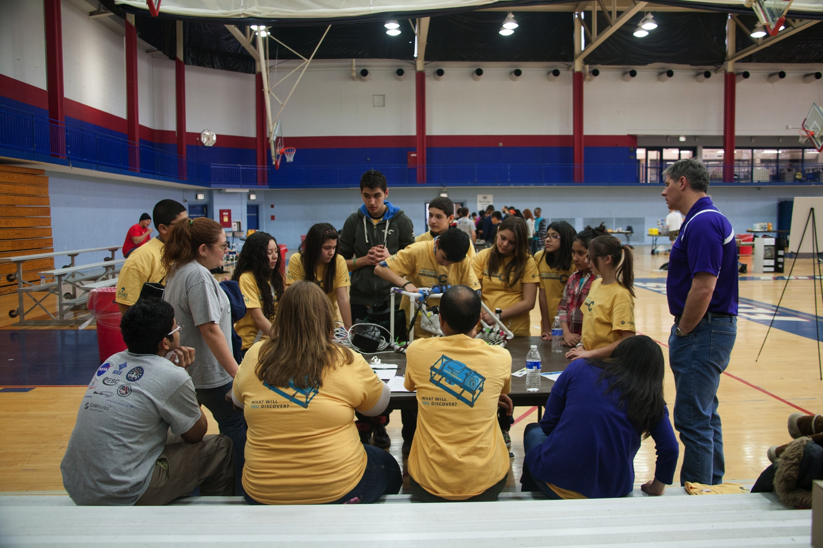
Introduction
Manipulator
Measuring Tool
Turning Motors
Thrusters
Electronics Box
Frame
Cameras
Buoyancy & Ballast
Tether
Pneumatics
Transmissometer
Electronics
Software
Expenses
Safety
Scheduling
Outreach
Acknowledgements
Outreach
Working with nearby Ranger class teams at Regional Competition
Helping to spread STEM to youth

Slide 34













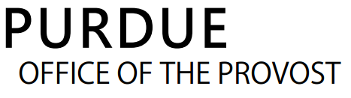
Acknowledgements
Introduction
Manipulator
Measuring Tool
Turning Motors
Thrusters
Electronics Box
Frame
Cameras
Buoyancy & Ballast
Tether
Pneumatics
Transmissometer
Electronics
Software
Expenses
Safety
Scheduling
Outreach
Acknowledgements
All judges of the MATE Competition
Clement Lan and Clayton Kleppinger
Rob Swanson
Lawrence Goldstein
Seth Baklor and Spencer Julian
Jason Gary and Danielle Lan
Ross Howard
Char Swanson
Purdue Research Machining Services
Dr. Mark Johnson
Eta Kappa Nu, Beta Chapter
Purdue School of ECE
The Hayashi and Molo Families
Our Friends and Family

